Slide 1

MASTER FRANCKE · c. 1420–1435
The paintings are clear. The painter is missing.
Master Francke in seven works—and in contrast with Master Bertram
Seven works · two Hamburg masters · one art-historical reconstruction
MASTER FRANCKE · SEVEN WORKS
01
Notes:
We do not know his real name, and we cannot securely establish his birthplace or even his identity as a friar. Yet when art historians see flowing folds, saturated red, blue, and gold, and bodies compressed until suffering feels physical, they think of Master Francke. Through seven works, this video meets that painter without a face and places him beside the earlier Hamburg master, Bertram, to see how northern altarpiece painting moved from courtly order toward greater weight and emotional tension.
[Sources]
https://www.deutsche-biographie.de/gnd118692526.html#ndbcontent
https://online-sammlung.hamburger-kunsthalle.de/de/objekt/HK-492/die-anbetung-des-kindes

Slide 2

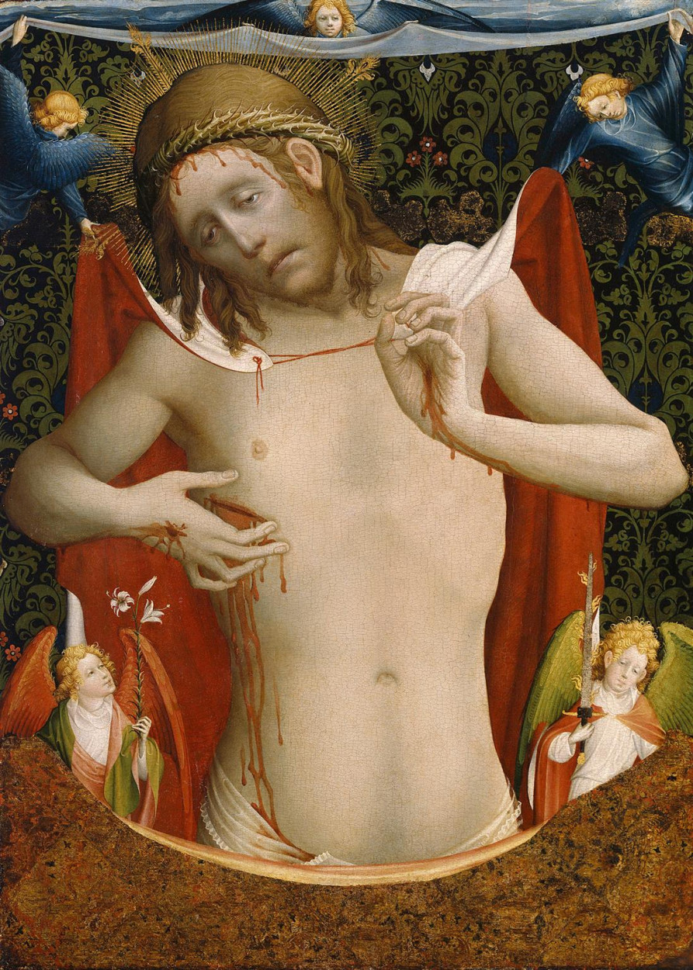
His style is more reliable than his biography
Real name? Birthplace? Friar? None is fully secure.
WHAT SURVIVES
— 1424: a record names mester Francken
— Works: a remarkably coherent style
— Life: hypotheses surrounded by gaps
MASTER FRANCKE · SEVEN WORKS
02
Notes:
Master Francke is not an artist whose complete life can be used to explain his pictures. The logic runs in reverse. We first recognize a vivid and coherent artistic personality in the paintings, then try to assemble scattered documents around it. A 1424 record connected with Hamburg's Englandfahrer names a mester Francken and provides the strongest bridge between a name and an altarpiece commission. A Zutphen origin and Dominican identity remain plausible, but they are not proven facts.
[Sources]
https://www.deutsche-biographie.de/gnd118692526.html#ndbcontent
https://online-sammlung.hamburger-kunsthalle.de/de/objekt/HK-490

Slide 3

Hamburg carried altarpieces into a maritime world
Merchants, monasteries, and Hanseatic routes shaped what sacred art could do
ENGLAND
HAMBURG
BALTIC
FINLAND
MERCHANT PATRONAGE
ALTARPIECES · MATERIALS · BELIEF
MASTER FRANCKE · SEVEN WORKS
03
Notes:
Francke's mature setting was Hamburg, a Hanseatic port whose merchants traveled between England and the Baltic. An altarpiece could therefore serve worship while also expressing corporate identity, overseas memory, and devotion to a chosen saint. The Thomas Altarpiece was probably made for the Englandfahrer chapel. Another work associated with Francke, the Kalanti Altarpiece, eventually stood in Finland. Here art was not confined to a court. It moved with trade, belief, materials, and institutional relationships.
[Sources]
https://online-sammlung.hamburger-kunsthalle.de/de/objekt/HK-490
https://www.kansallismuseo.fi/en/digitaalinen-kokoelma/aarteita-suomen-kansallismuseon-nayttelyissa/toista-maata/kalannin-alttarikaappi-1-1

Slide 4

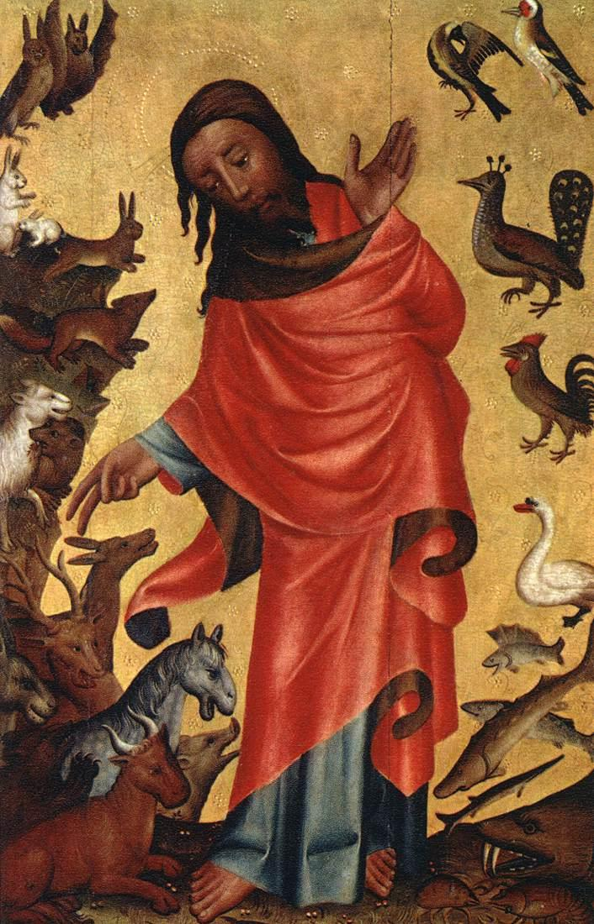
Bertram had already built Hamburg's altarpiece tradition
The Grabow Altarpiece, c. 1383: clear contour, brilliant color, ordered space
BERTRAM'S PICTORIAL LANGUAGE
Clear, flowing contour
Brilliant, decorative color
Figures remain legible within order
MASTER FRANCKE · SEVEN WORKS
04
Notes:
Francke did not emerge into an empty city. Roughly four decades earlier, Master Bertram had established a mature model of monumental Hamburg altarpiece painting in the Grabow Altarpiece. In The Creation of the Animals, God and the creatures occupy a lucid, readable pictorial order. Contours flow and colors shine like jewels. This courtly elegance and narrative clarity formed a tradition that Francke could inherit. The contrast is not a simple story of progress, but a change in how pictures accommodate bodily weight and emotional pressure.
[Sources]
https://commons.wikimedia.org/wiki/File:Meister_Bertram_von_Minden_-_Creation_of_the_Animals,_panel_from_Grabow_Altarpiece_-_WGA14311.jpg
https://online-sammlung.hamburger-kunsthalle.de/de/objekt/HK-490

Slide 5

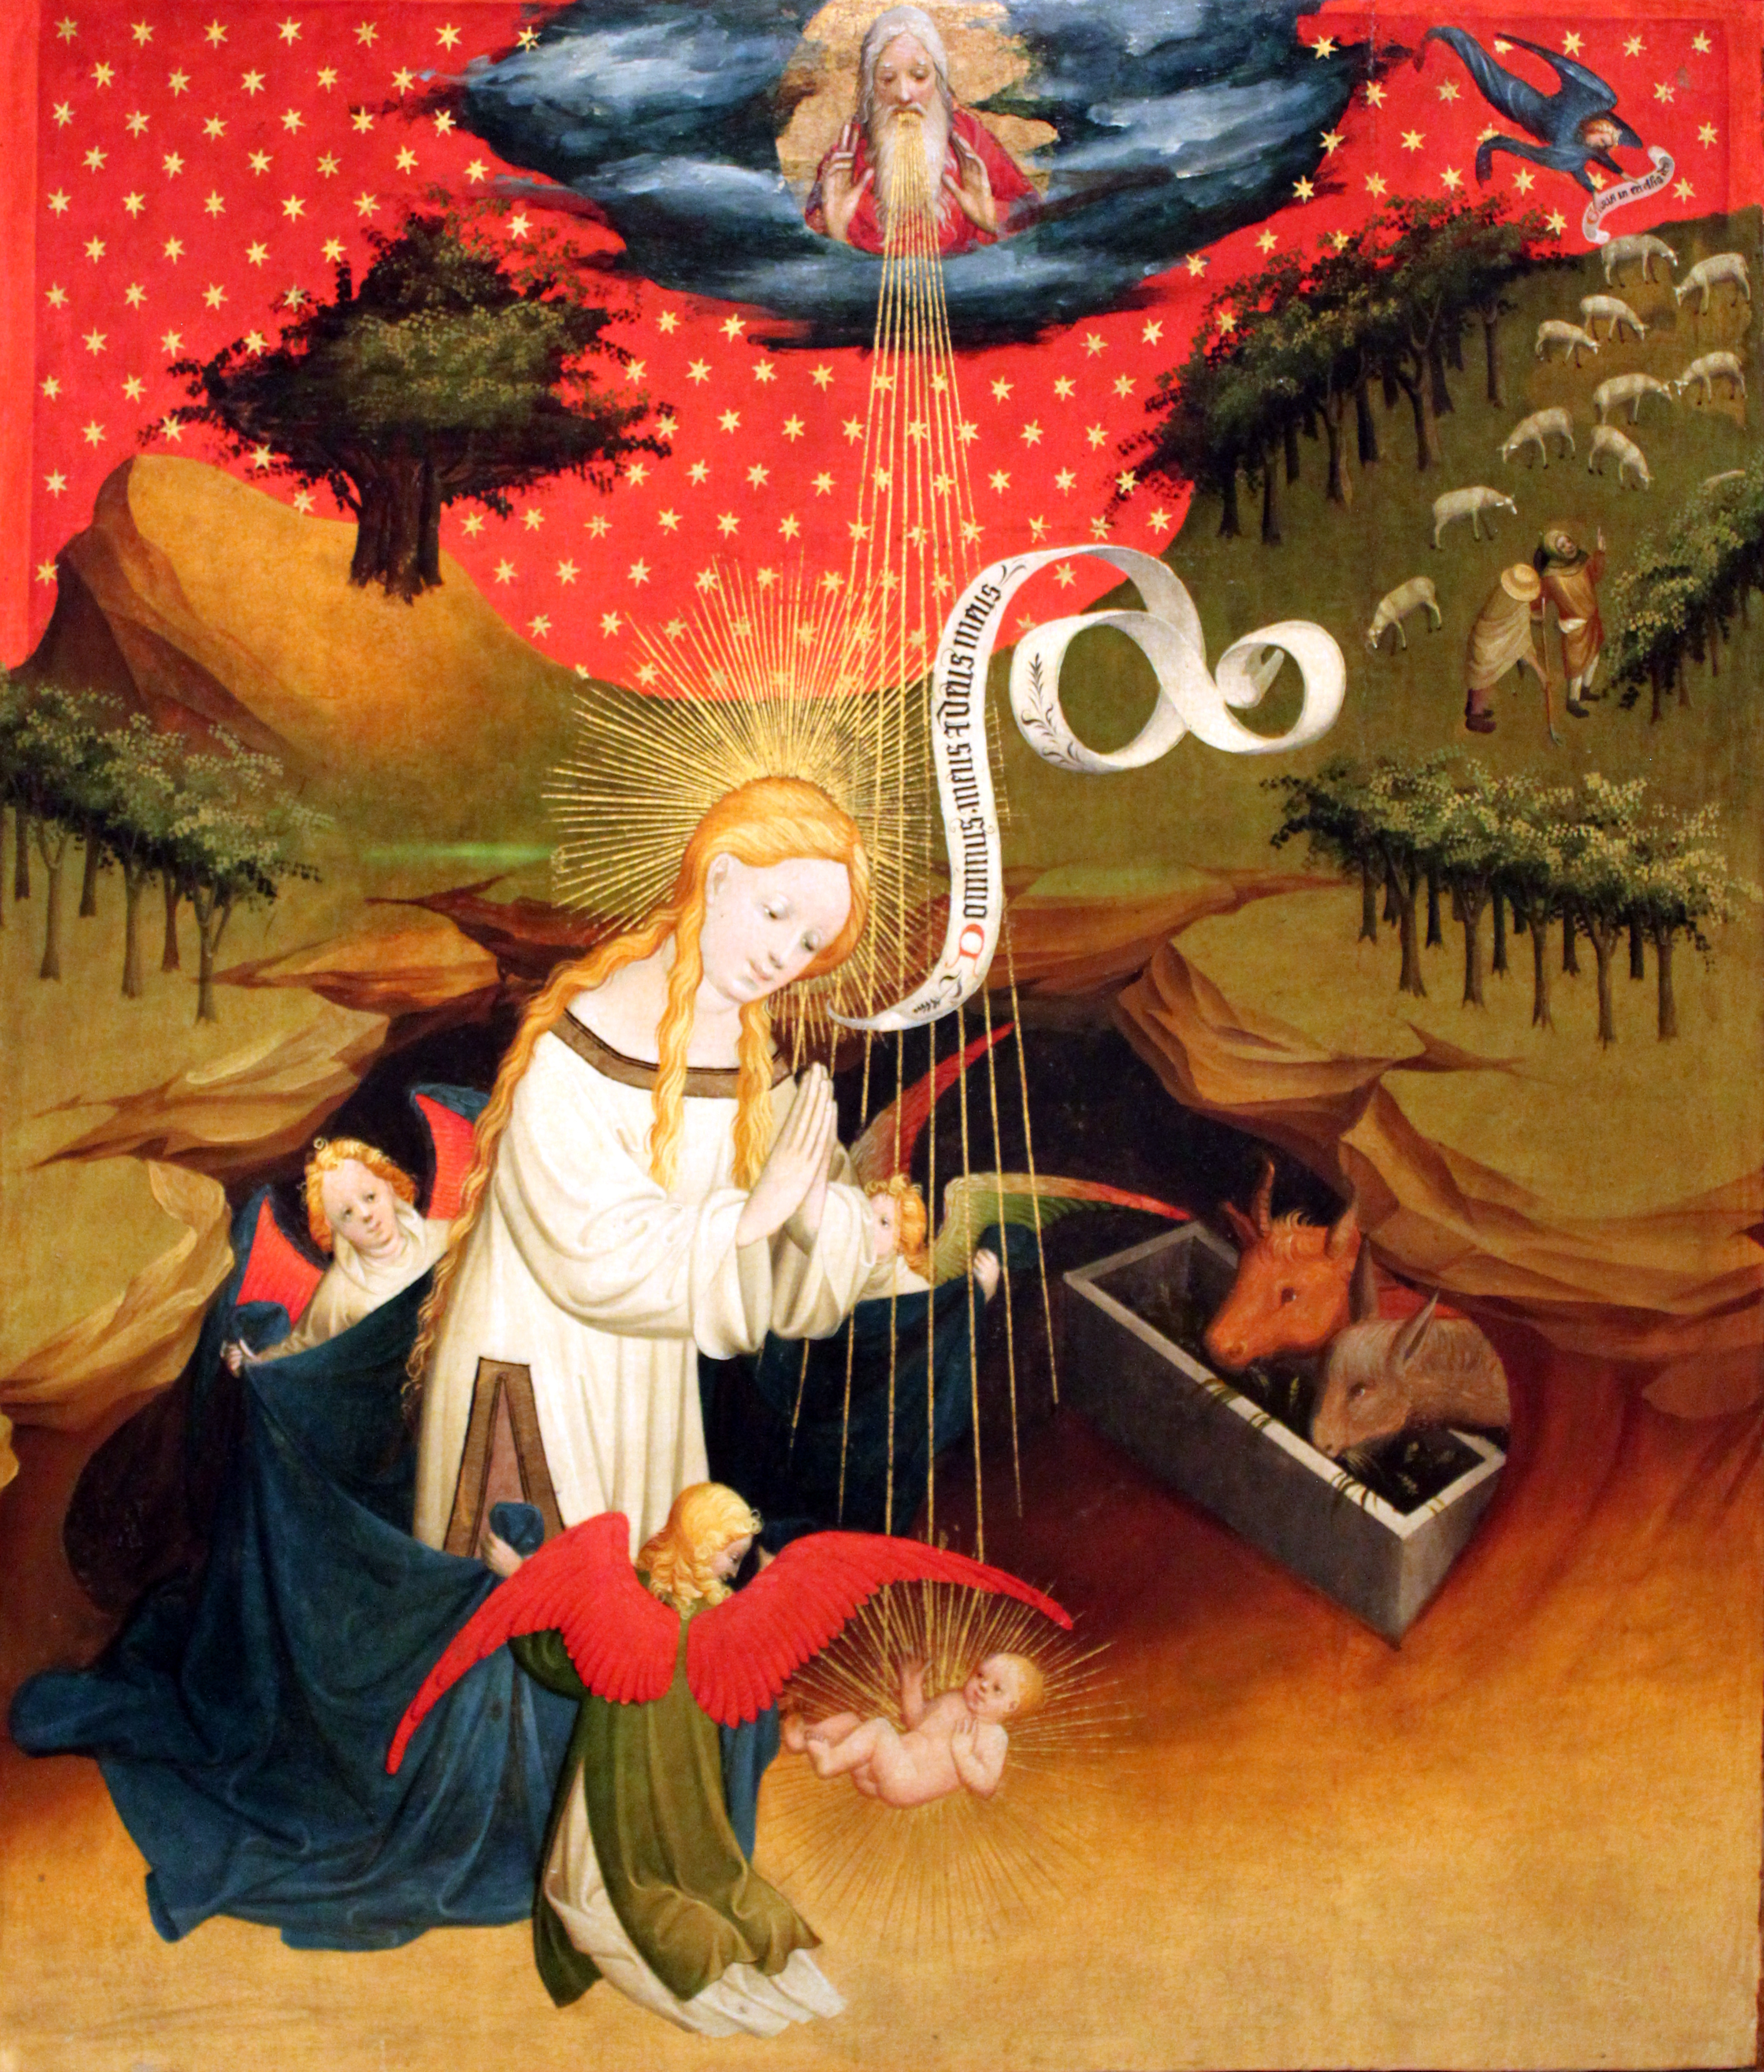
The splendor remains; the bodies feel different
Bertram, The Creation of the Animals | Francke, Adoration of the Child
ORDER
→
WEIGHT & EMOTION
MASTER BERTRAM
MASTER FRANCKE
MASTER FRANCKE · SEVEN WORKS
05
Notes:
Placed side by side, the paintings first reveal common ground: gold, saturated color, elegant curves, and an ability to turn sacred narrative into a precious image. Bertram distributes God and the animals clearly, giving each form a legible place. Francke brings the Virgin close to the Child, lets angels support a mantle behind her, and layers rock, cloth, body, and divine rays. Bertram's panel feels like rhythmic order. Francke's picture moves the viewer closer to bodies and, with them, closer to emotion.
[Sources]
https://commons.wikimedia.org/wiki/File:Meister_Bertram_von_Minden_-_Creation_of_the_Animals,_panel_from_Grabow_Altarpiece_-_WGA14311.jpg
https://online-sammlung.hamburger-kunsthalle.de/de/objekt/HK-492/die-anbetung-des-kindes
https://commons.wikimedia.org/wiki/File:1426_Meister_Francke_Die_Anbetung_des_Kindes_anagoria.JPG

Slide 6

This is stylistic development, not a teacher–student lineage
From courtly order to bodily pressure: different choices by two Hamburg masters
MASTER BERTRAM
MASTER FRANCKE
Clear contour
Stronger volume
Balanced placement
Occluding bodies
Decorative color
Diagonal force
Courtly elegance
Emotional tension
NO DOCUMENTED TEACHER–STUDENT LINK
MASTER FRANCKE · SEVEN WORKS
06
Notes:
One boundary matters when comparing these painters: no evidence establishes a direct teacher–student relationship. Bertram often builds narrative through clear contour, decorative color, and balanced order. Francke preserves that elegant surface but increases volume, occlusion, diagonal force, and emotional tension. He does not reject International Gothic. Instead, he introduces weight, violence, fear, and mourning into its graceful language. The comparison identifies a shift in pictorial priorities, not a documented genealogy.
[Sources]
https://www.deutsche-biographie.de/gnd118692526.html#ndbcontent
https://online-sammlung.hamburger-kunsthalle.de/de/objekt/HK-490

Slide 7

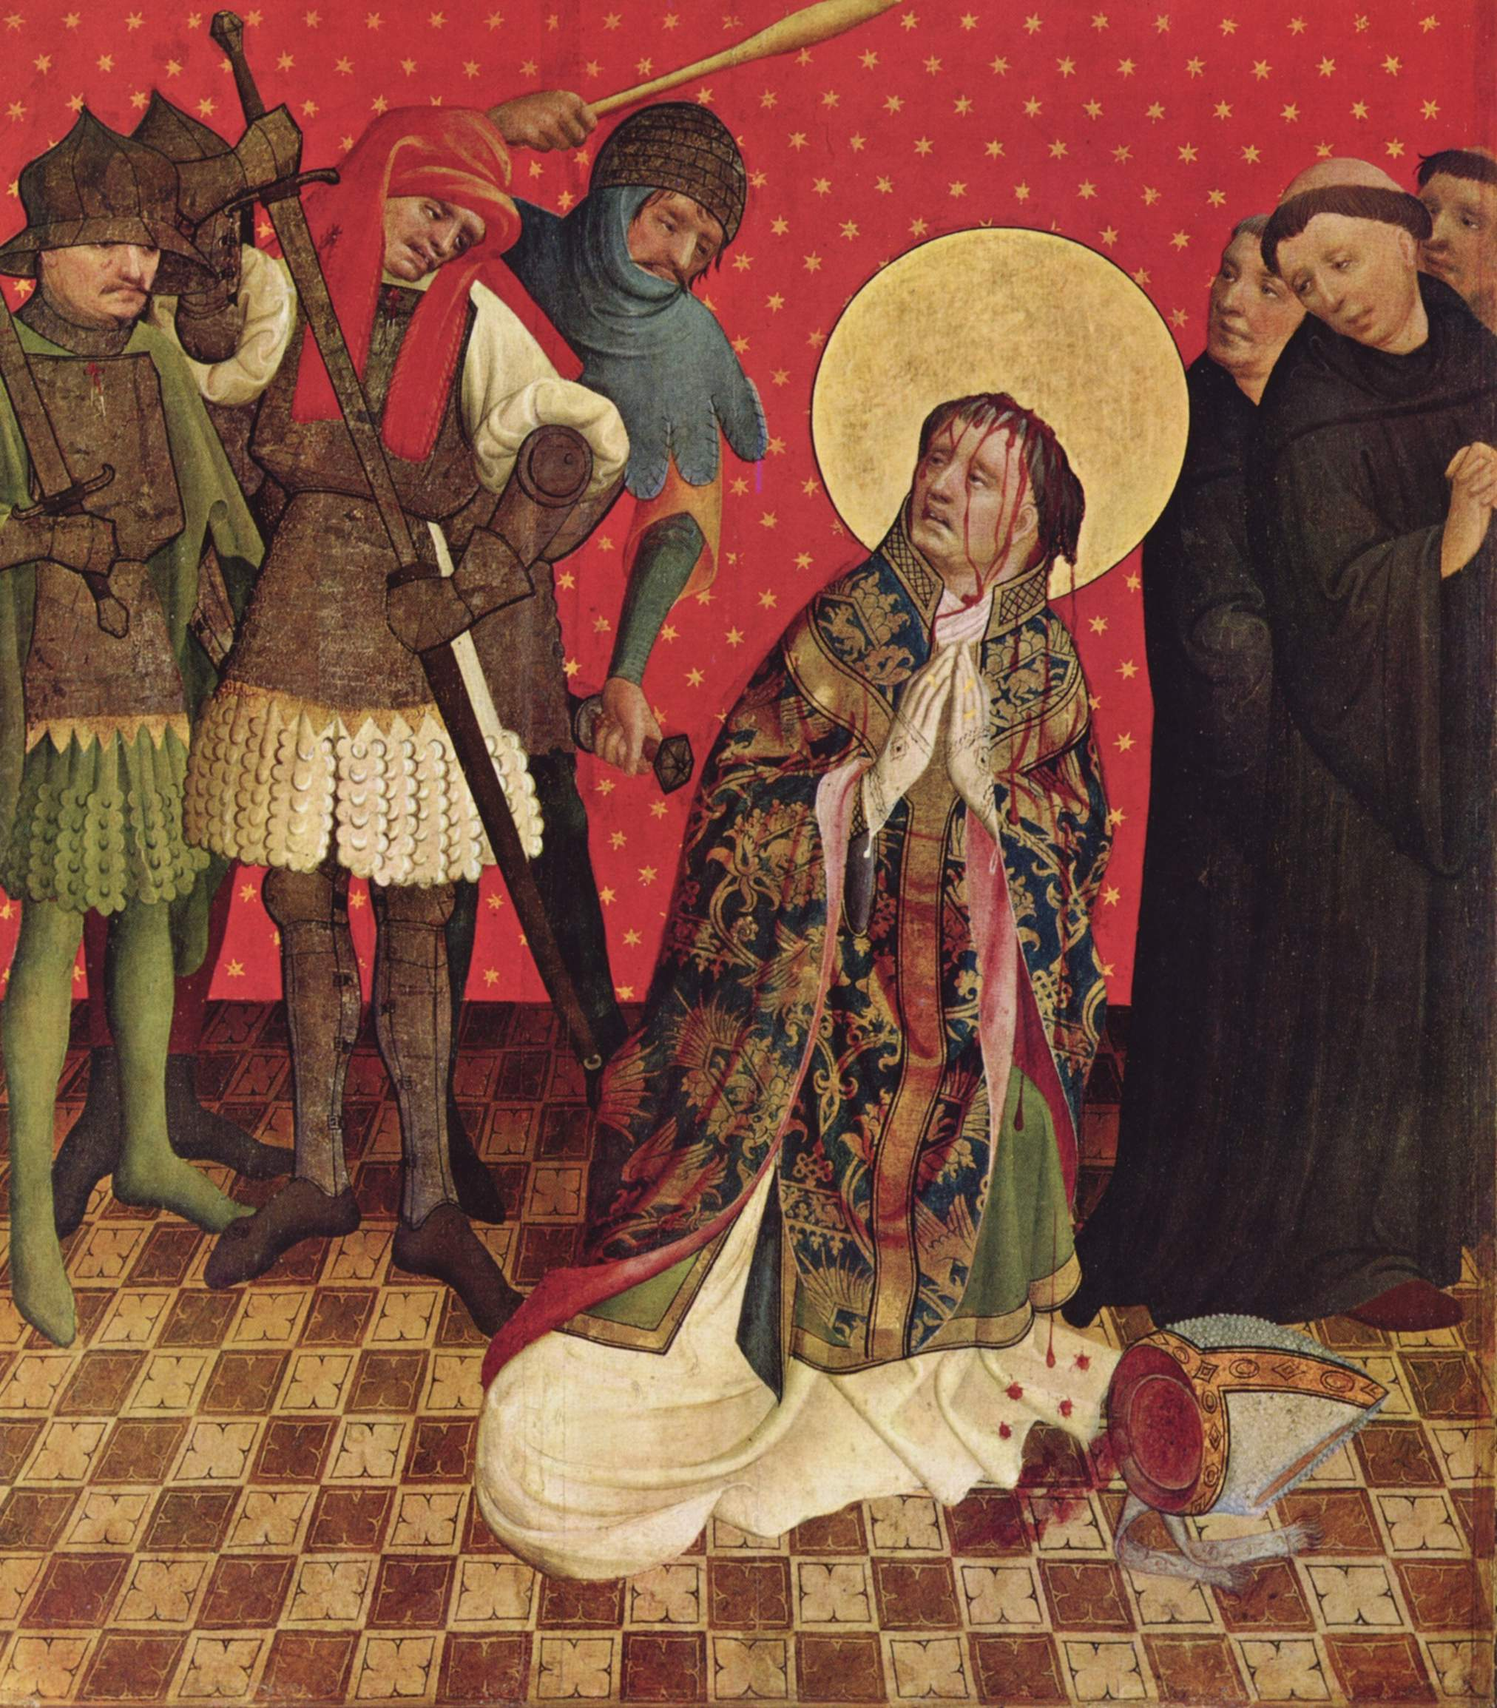
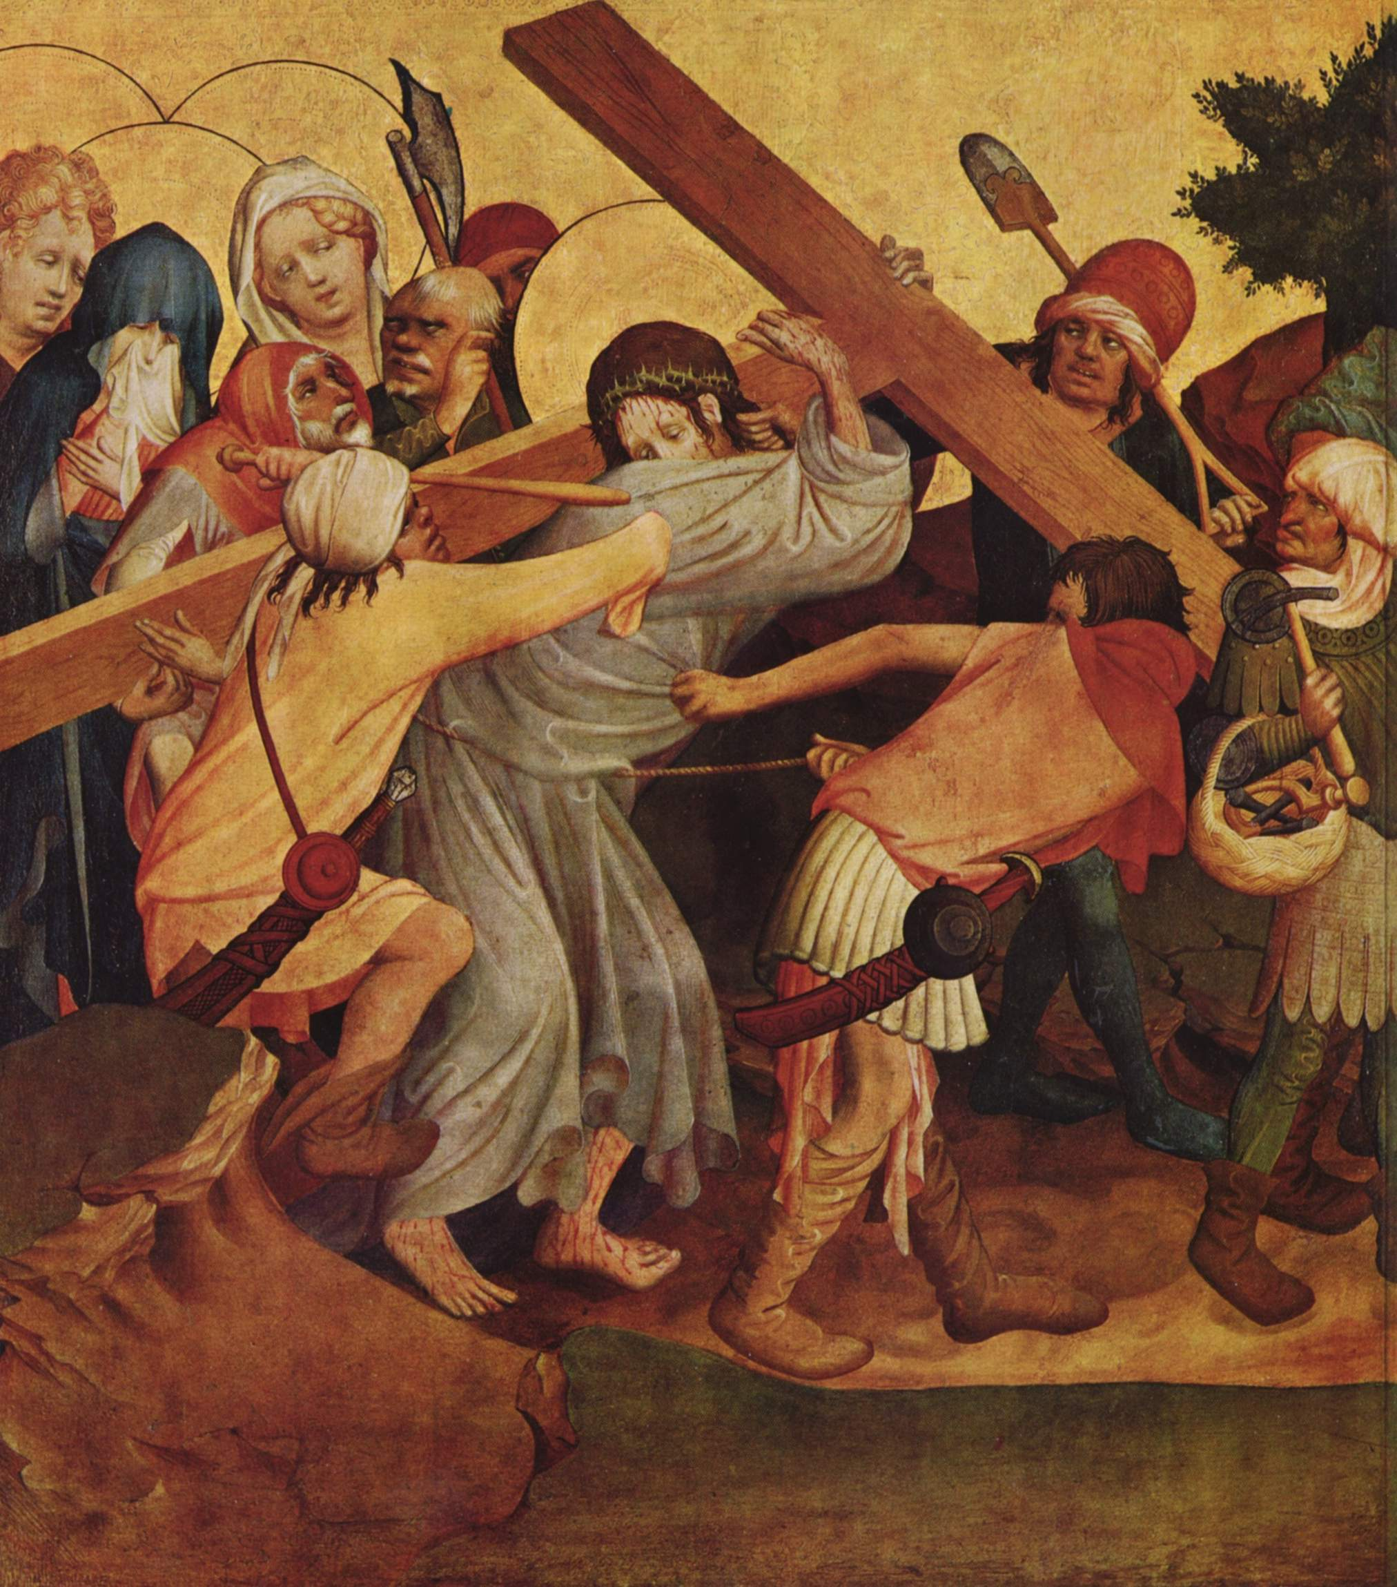
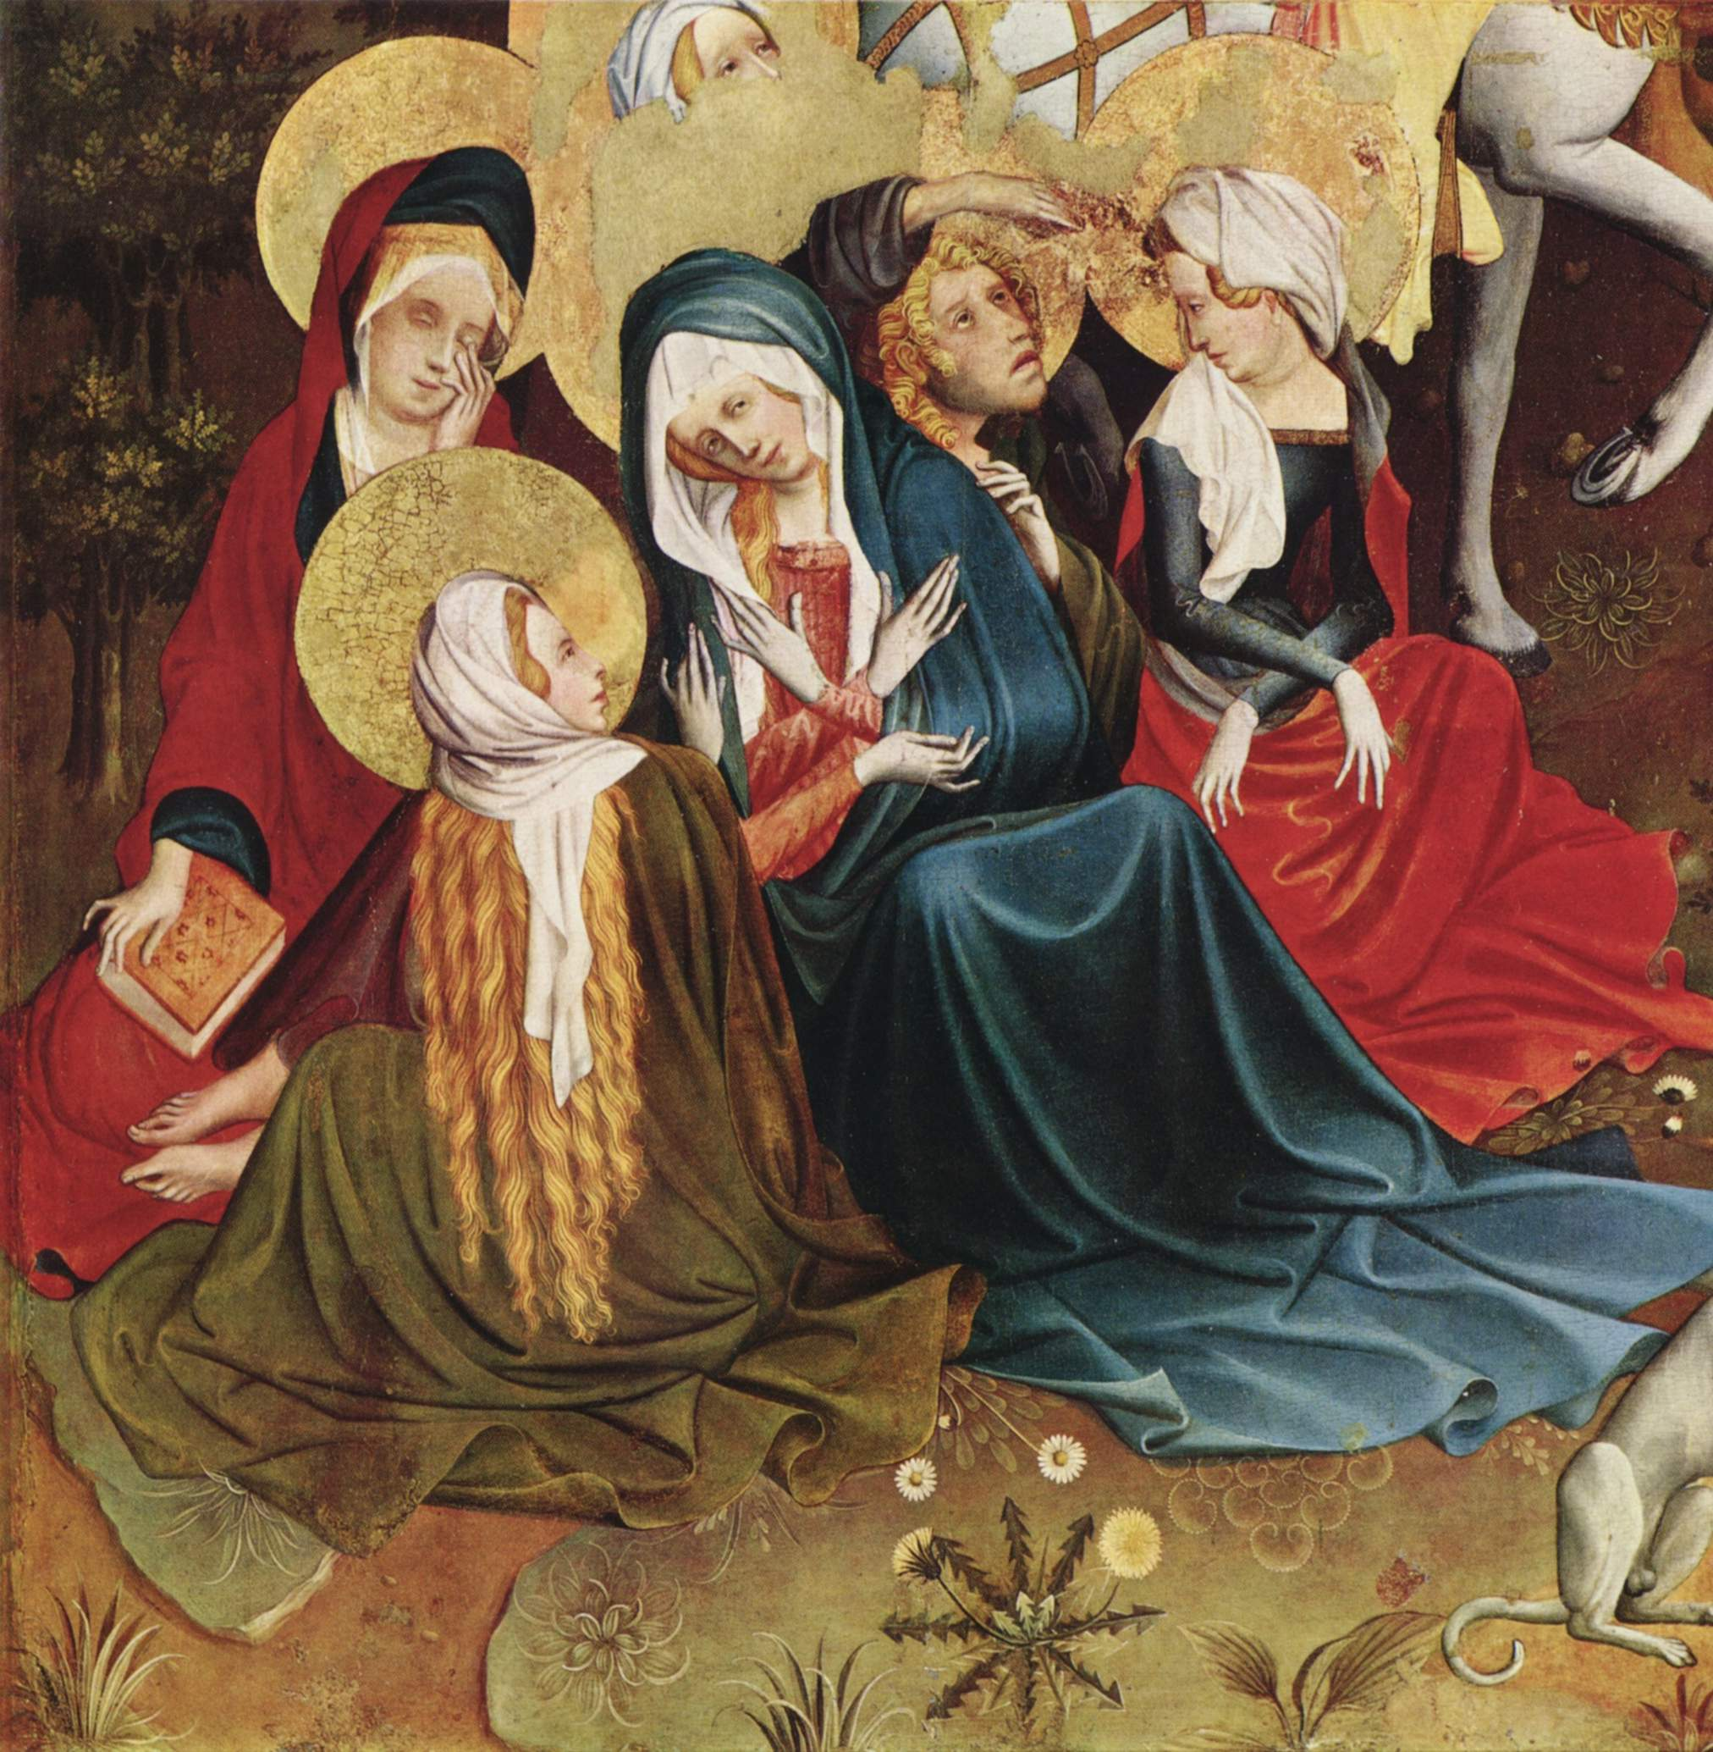
The Thomas Altarpiece changed as its wings opened
Nine panels survive: eight fuller scenes and one Crucifixion fragment
Opening changed the imagery; today's arrangement is a reconstruction, not the intact original.
MASTER FRANCKE · SEVEN WORKS
07
Notes:
The museum now displays nine separated panels, but the original was a compound altarpiece that could be opened twice. One opening probably revealed episodes from the Virgin's life and the story of Thomas Becket; a further opening exposed Passion imagery against gold. The reconstruction relies partly on an engraving made in 1731, so it is evidence-based without being a perfect copy of the lost arrangement. The next four works come from this altarpiece and show Francke moving between sacred light, violence, pressure, and grief.
[Sources]
https://online-sammlung.hamburger-kunsthalle.de/de/objekt/HK-490
https://online-sammlung.hamburger-kunsthalle.de/de/objekt/HK-492/die-anbetung-des-kindes

Slide 8

Adoration of the Child: light becomes theology
01 / 07
c. 1426 | Hamburger Kunsthalle, HK-492
The Virgin kneels in white
Angels hold her blue mantle
Gold rays cross a red, starry sky
MASTER FRANCKE · SEVEN WORKS
08
Notes:
The Virgin does not sit on a throne. Dressed almost entirely in white, she kneels before the naked Child while three angels hold her blue mantle. Golden rays pass through a red, star-filled sky and point directly toward the infant. The composition relates to Saint Bridget of Sweden's vision of the Nativity. Francke is not studying the behavior of lamplight inside a room. He is making belief visible: the Child is illuminated, yet also appears to be the source of illumination.
[Sources]
https://online-sammlung.hamburger-kunsthalle.de/de/objekt/HK-492/die-anbetung-des-kindes
https://commons.wikimedia.org/wiki/File:1426_Meister_Francke_Die_Anbetung_des_Kindes_anagoria.JPG

Slide 9

Martyrdom of Thomas Becket: beauty makes violence abrupt
02 / 07
c. 1426 | Hamburger Kunsthalle, HK-491
Weapons cut diagonal paths
Bodies overlap
The archbishop's mitre falls
MASTER FRANCKE · SEVEN WORKS
09
Notes:
Becket kneels before an altar as attackers enter from the side. Weapons slice diagonally through the panel, bodies overlap, and the archbishop's mitre drops amid the confusion. Francke retains sumptuous vestments and jewel-like color instead of abandoning beauty. Their presence makes the murder more startling: violence breaks into an image that still appears precious and ordered. The viewer's eye follows the weapons downward and arrives at the body as it loses balance.
[Sources]
https://online-sammlung.hamburger-kunsthalle.de/de/objekt/HK-490
https://commons.wikimedia.org/wiki/File:Meister_Francke_011.jpg

Slide 10

Christ Carrying the Cross: crowding becomes pain
03 / 07
c. 1428 | Hamburger Kunsthalle, HK-495
Almost no breathing room
Cross, arms, and faces create pressure
Medieval anti-Jewish stereotypes require context
MASTER FRANCKE · SEVEN WORKS
10
Notes:
The foreground offers almost no breathing room. Cross, arms, faces, and bodies form a dense field of diagonals, so Christ's suffering emerges not only from expression but from weight, resistance, and collision. Some hostile figures employ negative stereotypes of Jewish people found in medieval Christian imagery. They must be understood as evidence of historical prejudice, not neutral portraits of a real community. Looking responsibly includes recognizing the harmful visual traditions a work carries.
[Sources]
https://online-sammlung.hamburger-kunsthalle.de/de/objekt/HK-490
https://commons.wikimedia.org/wiki/File:Meister_Francke_009.jpg

Slide 11

Mourning Women: grief is carried by a group
04 / 07
c. 1435 | Hamburger Kunsthalle, HK-496 | Crucifixion fragment
Bowed heads
Interlocking arms
Folds draw the group inward
MASTER FRANCKE · SEVEN WORKS
11
Notes:
Only the lower-left portion of the original central Crucifixion survives, yet it preserves one of Francke's most moving emotional structures. The women support one another. Grief is not reduced to a single exaggerated face; it emerges through bowed heads, interlocking arms, enveloping cloth, and a group contracting inward. Once a detail within a much larger narrative, the fragment now resembles an independent image of collective mourning. Here sorrow is not an expression. It is weight shared by bodies.
[Sources]
https://online-sammlung.hamburger-kunsthalle.de/de/objekt/HK-490
https://commons.wikimedia.org/wiki/File:Meister_Francke_005.jpg

Slide 12

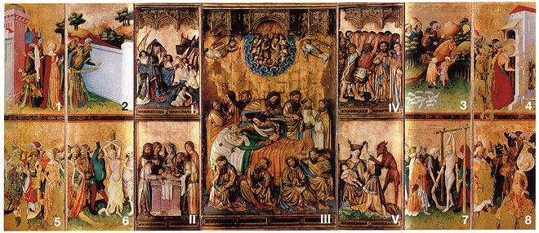
The Kalanti Altarpiece: an object crosses the Baltic
05 / 07
National Museum of Finland's current dating: 1430s | open: c. 200 × 260 cm
— Eight wing scenes narrate Saint Barbara's martyrdom
— Painting and sculpture came from different makers
— No document proves the patron or transport route
MASTER FRANCKE · SEVEN WORKS
12
Notes:
Fully opened, the altarpiece measures about two meters high and 2.6 meters wide. Eight painted wing scenes narrate Saint Barbara's resistance, conversion, torture, and death, while the center and inner wings combine sculpture with painting. The National Museum of Finland currently dates Francke's painted contribution to the 1430s; older scholarship proposed earlier dates. No surviving document identifies the patron or the route from Hamburg to Kalanti. Its safest significance is that painting, carving, and religious ideas traveled through the Baltic world.
[Sources]
https://www.kansallismuseo.fi/en/digitaalinen-kokoelma/aarteita-suomen-kansallismuseon-nayttelyissa/toista-maata/kalannin-alttarikaappi-1-1
https://commons.wikimedia.org/wiki/File:Pyh%C3%A4n_Barbaran_alttarikaappi.jpg

Slide 13

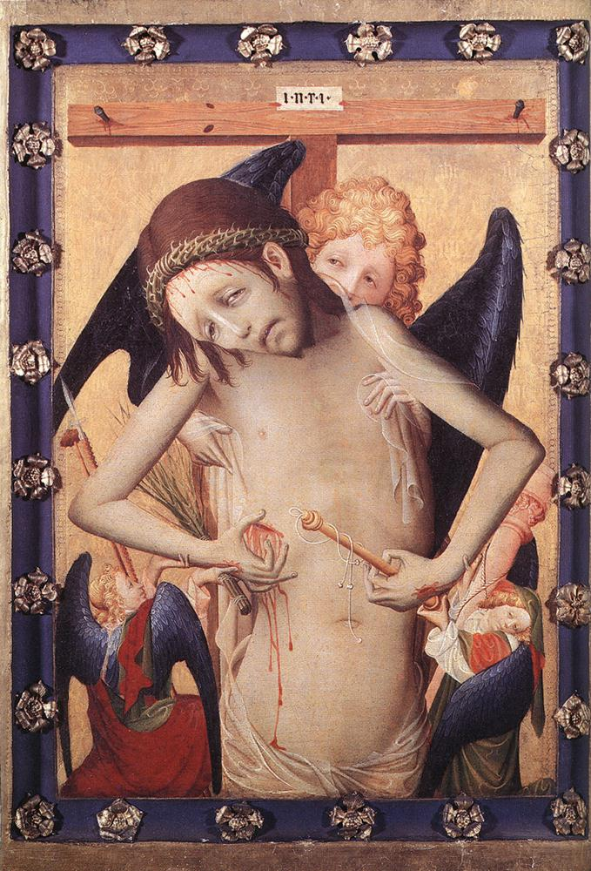
Leipzig Man of Sorrows: narrative recedes and wounds approach
06 / 07
c. 1420 | Museum der bildenden Künste Leipzig
Angels support the wounded Christ
No continuous Passion narrative
Designed for close devotional looking
MASTER FRANCKE · SEVEN WORKS
13
Notes:
In Leipzig's Man of Sorrows, angels support the wounded Christ. The painting does not recount a sequence of Passion events. Instead, wounds, blood, and gaze are concentrated directly before the viewer. Compared with the crowded drama of the Thomas Altarpiece, background actors and narrative distance disappear, intensifying the emotional pressure. The image is suited to close devotional looking: rather than observing history from afar, the viewer confronts an injured body that still meets the viewer's eyes.
[Sources]
https://mdbk.de/sichtbarmachen/
https://commons.wikimedia.org/wiki/File:Meister_Francke_-_Vir_Dolorum_(Man_of_Sorrows)_-_WGA14324.jpg

Slide 14

Hamburg Man of Sorrows: “attributed to” keeps doubt visible
07 / 07
c. 1435 | Hamburger Kunsthalle | attributed to Francke / workshop
Style and technique support the attribution
Not every stroke can be proven autograph
The catalogue can still change
MASTER FRANCKE · SEVEN WORKS
14
Notes:
Hamburg preserves another Christ as Man of Sorrows, but the museum uses the cautious language attributed to Master Francke or associated with his workshop. That phrase matters. Style, technique, or relationships among works support the attribution, but the evidence cannot prove that every stroke was made by the master himself. For an artist without signatures and with very little documentation, stylistic recognition is evidence, not a substitute for material analysis, provenance, and research that remains open to revision.
[Sources]
https://online-sammlung.hamburger-kunsthalle.de/de/objekt/HK-490
https://commons.wikimedia.org/wiki/File:Meister_Francke_-_Schmerzensmann_-_Hamburger_Kunsthalle.jpg

Slide 15

The works returned before the name did
1859: group recognized → 1898: panels return to Hamburg → 1899: the 1424 name surfaces
1859
1898
1899
The group is recognized
Nine panels return to Hamburg
The 1424 name is found
MASTER FRANCKE · SEVEN WORKS
15
Notes:
Master Francke was not discovered in a single moment. During the nineteenth century, scholars first recognized one artistic personality across dispersed panels. In 1898, the nine Thomas Altarpiece panels entered the Hamburger Kunsthalle. Only in the following year did an archivist find the 1424 record naming mester Francken. Modern art history therefore did not begin with a known person and search for his pictures. It first assembled the pictures into an artist, and only then recovered a name from the archive.
[Sources]
https://www.deutsche-biographie.de/gnd118692526.html#ndbcontent
https://online-sammlung.hamburger-kunsthalle.de/de/objekt/HK-490

Slide 16
Recognizing a style is not the same as recognizing a person
Flowing folds | saturated red, blue, white, and gold | compressed groups | elegance beside pain
FLOWING FOLDS
SATURATED COLOR
COMPRESSED GROUPS
ELEGANCE × PAIN
MASTER FRANCKE · SEVEN WORKS
16
Notes:
To recognize Francke, remember four visual clues: long, flowing folds; saturated red, blue, white, and gold; tilted groups compressed through overlap; and the coexistence of elegance with cruelty, divine light with tactile flesh. Beside Bertram, he moves Hamburg's altarpiece tradition closer to bodily weight and emotional pressure. Yet identifying these features does not reveal his real name. The paintings speak with extraordinary clarity while their maker remains almost silent. That contradiction is the enduring mystery of Master Francke.
[Sources]
https://www.deutsche-biographie.de/gnd118692526.html#ndbcontent
https://online-sammlung.hamburger-kunsthalle.de/de/objekt/HK-492/die-anbetung-des-kindes

Slide 17
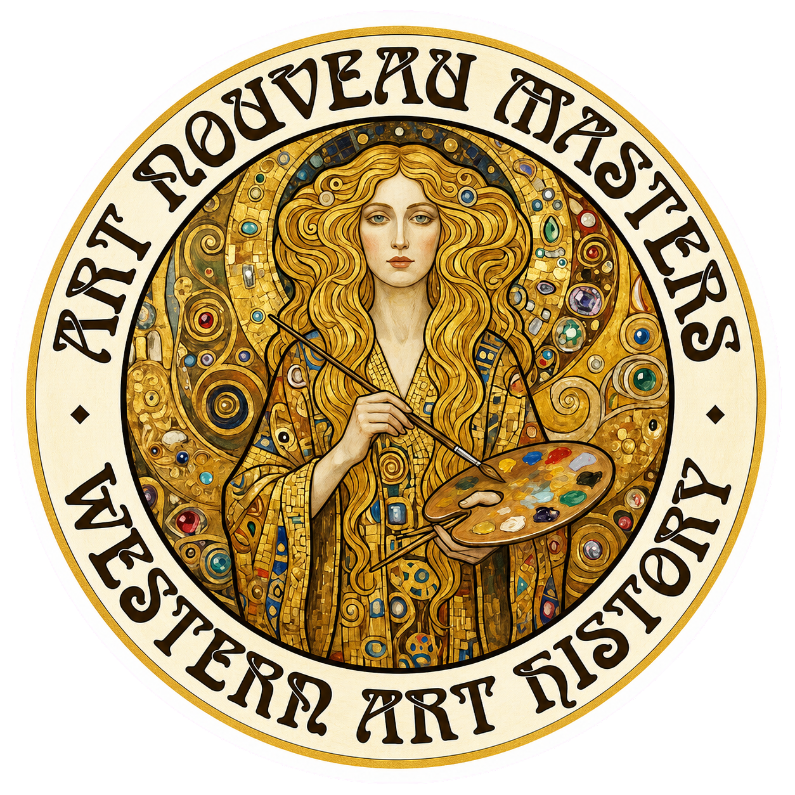
Notes:
Thank you for watching. The next time you stand before a medieval altarpiece, I hope you notice the weight and emotion beneath its elegant surface. See you next time!

